Slide 1
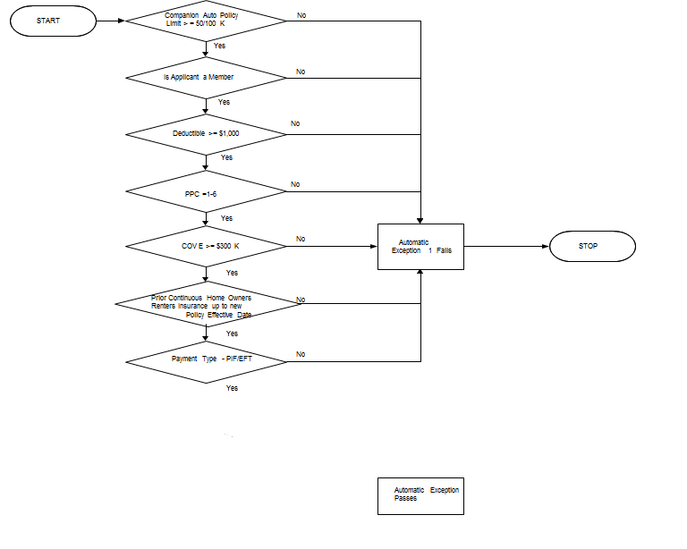
Automatic Exception 1 Flow
STATE CA Policy Type = HO3, HO6, DP3

Slide 2
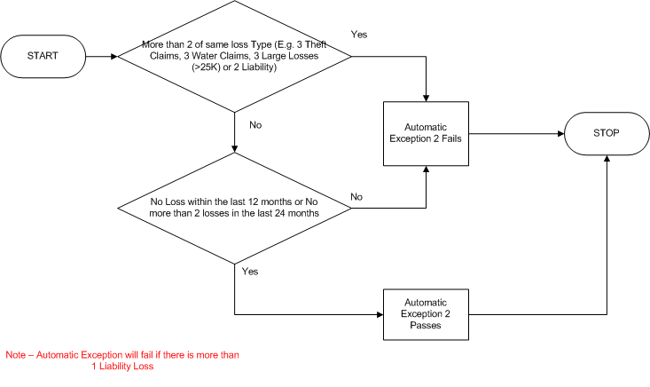
Automatic Exception 2 Flow
STATE CW Policy Type = HO3, HO6, DP3

Slide 3
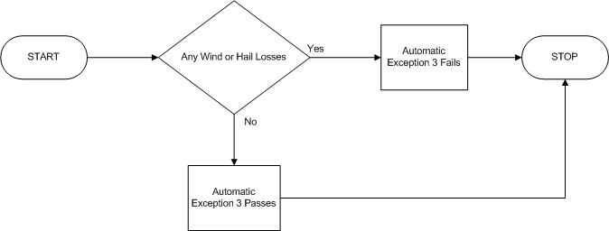
Automatic Exception 3 Flow
STATE CW Policy Type = HO3, HO6, DP3

Slide 4
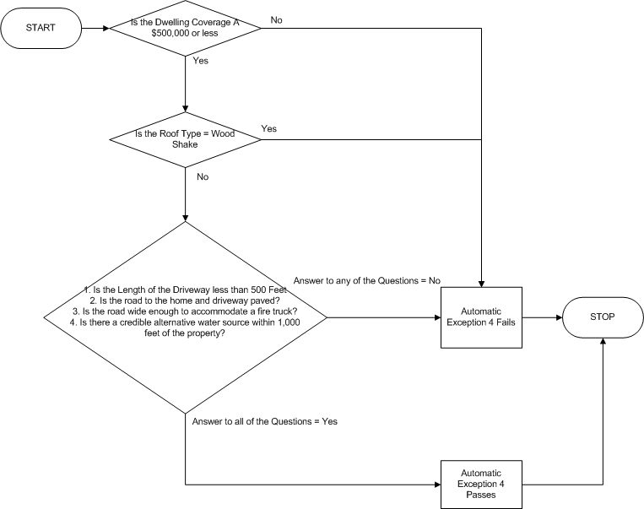
Automatic Exception 4 Flow
STATE CW Policy Type = HO3, HO6, DP3

Slide 5
Automatic Exception 6 Flow
STATE UT, AZ, Policy Type = HO3, HO6, DP3
Start
Zip match?
Yes
AE6 Pass
No
AE6 Fail

Slide 6
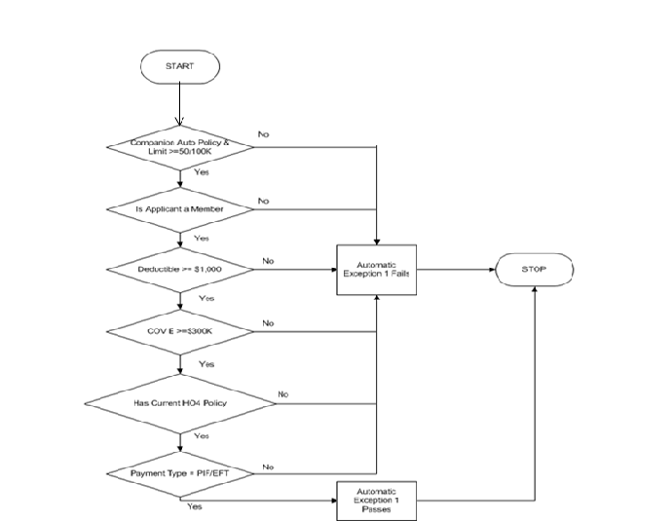
Automatic Exception 1 Flow
STATE CA Policy Type = HO4

Slide 7
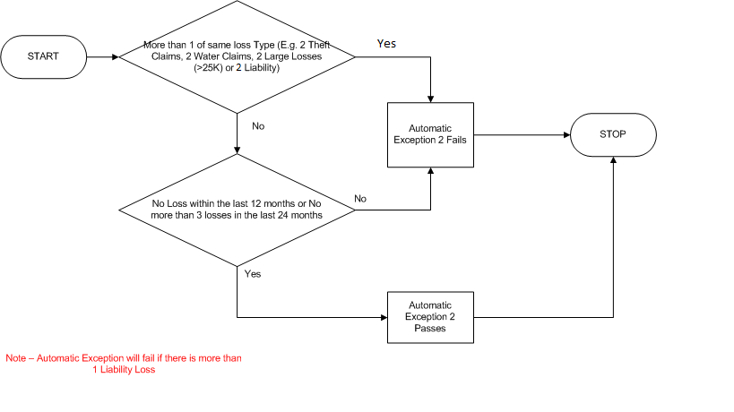
Automatic Exception 2 Flow
STATE CA Policy Type = HO4
2

Slide 8
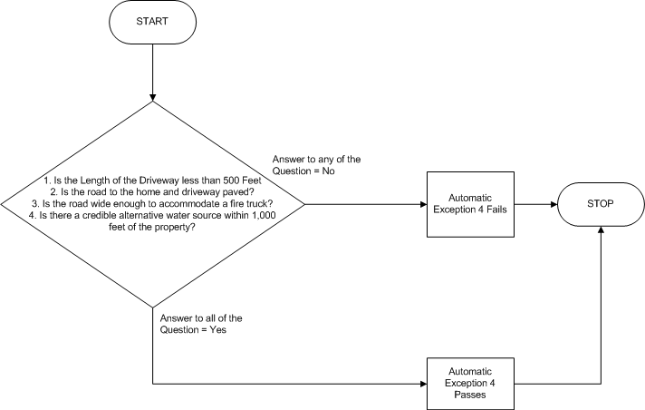
Automatic Exception 4 Flow
STATE CW Policy Type = HO4

